Slide 1
Contingent convertible bond 模型設計
古豐上

Slide 2
背景
2007年的次級房貸危機(subprime mortgage crisis)，使得原先由美國房市引發的風險開始由放貸銀行傳染到各種金融機構，其中對保險公司與投資銀行的影響更為深遠。

Slide 3
面臨問題
危機發生前屬於資本充足的公司
→原有的銀行監理制度有缺陷
大到不能倒(Too Big to Fail) → 道德風險
助長經營者投機的誘因(Bail out)
市場紀律功能喪失
→ 或有轉換債(Contingent convertible bond ,CC)

Slide 4
或有轉換債 (Contingent convertible bond ,CC)
在發行公司（或金融機構）財務狀況良好時，是ㄧ種債券商品，將定期支付CC投資者利息，並於到期時償還本金，同時發行公司則享有利息稅盾；然而當公司財務惡化時CC將「自動」且「強制地」轉換成普通股。
→ 如何設計良好的CC ？

Slide 5
文獻回顧(1/2)
Robert L. McDonald (2013)
CC的轉換應滿足雙重門檻 Ex. 股價 & 某相關指數
採用Fixed share“premium”conversion (FSW)可以防止CC持有人對股價操縱，轉換方式較佳。
但我們發現此時Equity Holders傾向操作股價
→Multiple Equilibria

Slide 6
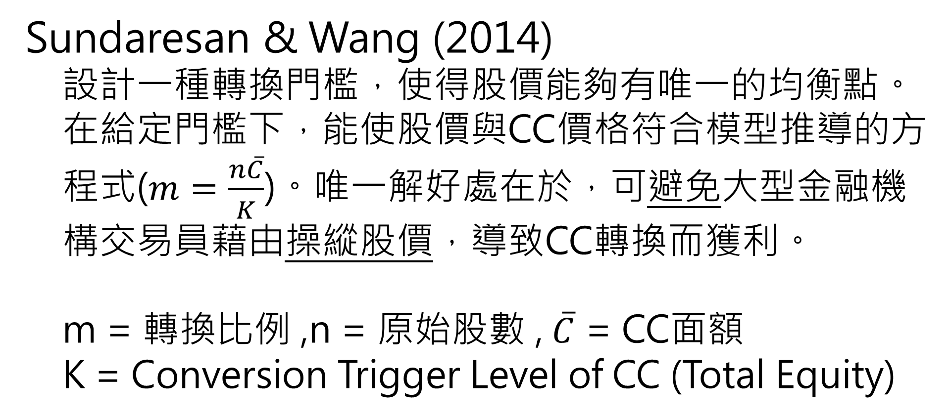
文獻回顧(2/2)
Sundaresan & Wang (2014)
設計一種轉換門檻，使得股價能夠有唯一的均衡點。在給定門檻下，能使股價與CC價格符合模型推導的方程式($m=\frac{n\overline{C}}{K}$)。唯一解好處在於，可避免大型金融機構交易員藉由操縱股價，導致CC轉換而獲利。
m = 轉換比例 ,n = 原始股數 , $\overline{C}$ = CC面額
K = Conversion Trigger Level of CC (Total Equity)

Slide 7

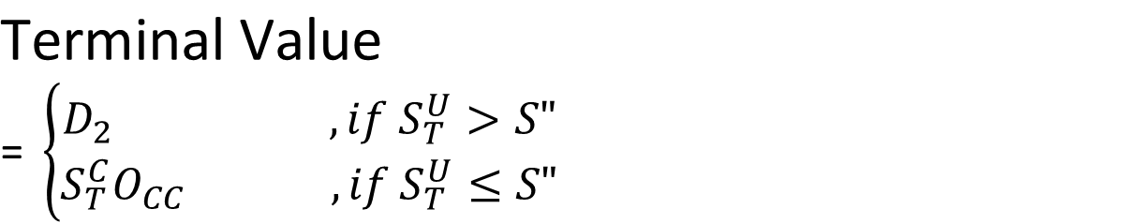
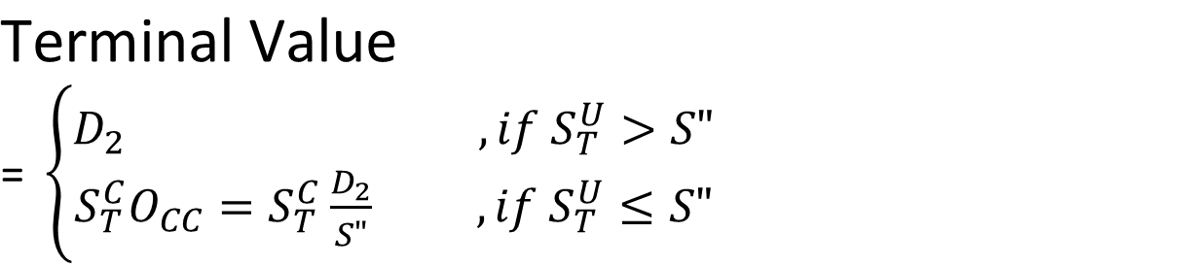
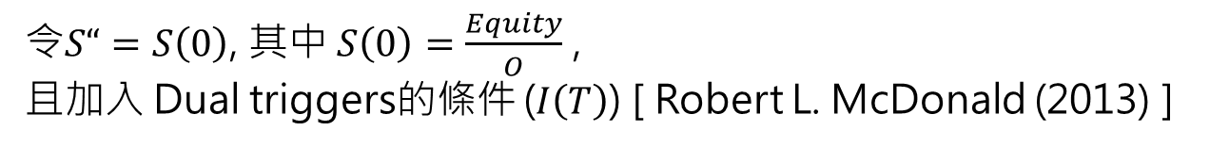
CC with dual triggers(CC)(1/2)
$$\text{Terminal} \text{Value}$$
$\text{= }\left\{\begin{aligned}D_{2} ,if S_{T}^{U}>S" \\ S_{T}^{C}O_{CC} ,if S_{T}^{U}≤S"\end{aligned}\right.$
為預防 多解(Multiple Equilibriums) 與 無解(No Equilibrium) 的問題
令$O_{CC}=\frac{D_{2}}{S“}$ , 其中 $S“=\frac{K}{n}$ [ Sundaresan & Wang (2014) ]
$$\text{Terminal} \text{Value}$$
$\text{= }\left\{\begin{aligned}D_{2} ,if S_{T}^{U}>S" \\ S_{T}^{C}O_{CC}=S_{T}^{C}\frac{D_{2}}{S"} ,if S_{T}^{U}≤S"\end{aligned}\right.$
令$S“=S\left(0\right)$, 其中 $S\left(0\right)=\frac{Equity}{O}$ ,
且加入 Dual triggers的條件 ($I\left(T\right)$) [ Robert L. McDonald (2013) ]

Slide 8
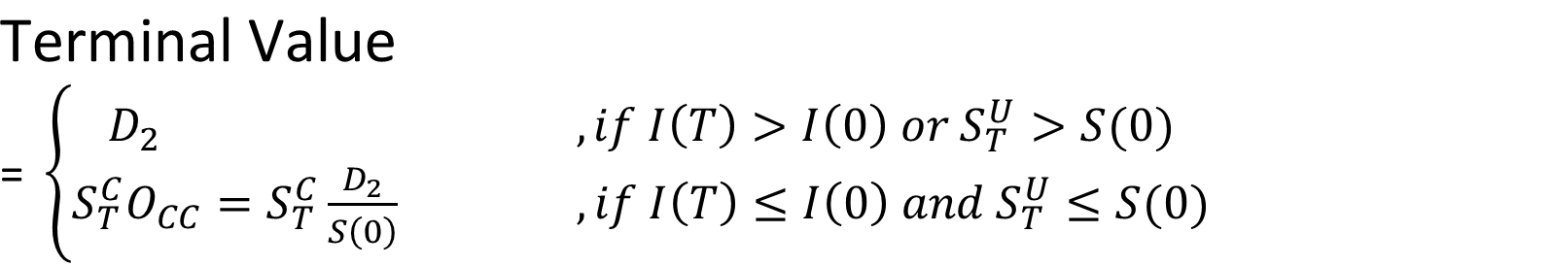
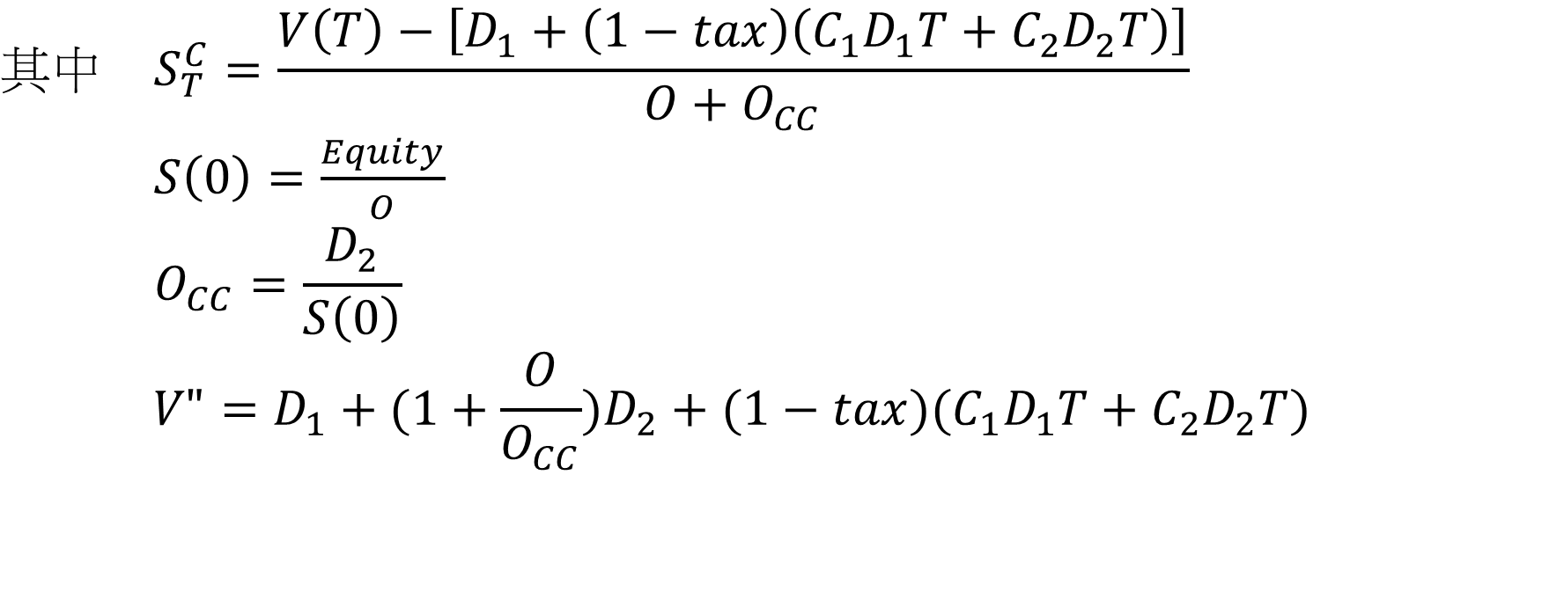
CC with dual triggers(CC)(2/2)
$$\text{Terminal} \text{Value}$$
$\text{= }\left\{\begin{aligned}D_{2} ,if I\left(T\right)>I\left(0\right) or S_{T}^{U}>S(0) \\ S_{T}^{C}O_{CC}=S_{T}^{C}\frac{D_{2}}{S\left(0\right)} ,if I\left(T\right)≤I\left(0\right) and S_{T}^{U}≤S(0)\end{aligned}\right.$
$$其中 S_{T}^{C}=\frac{V\left(T\right)−\left[D_{1}+\left(1−tax\right)\left(C_{1}D_{1}T+C_{2}D_{2}T\right)\right]}{O+O_{CC}}$$
$S\left(0\right)=\frac{Equity}{O}$
$$O_{CC}=\frac{D_{2}}{S\left(0\right)}$$
$$V"=D_{1}+(1+\frac{O}{O_{CC}})D_{2}+(1−tax)(C_{1}D_{1}T+C_{2}D_{2}T)$$

Slide 9

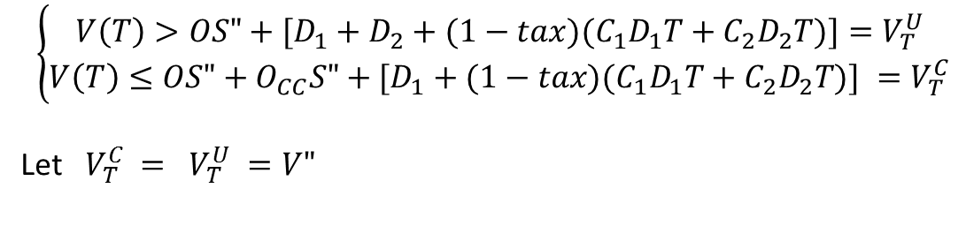

SB + CC 分析圖
$$\left(1−α\right)V\left(T\right)=D_{1}+C_{1}D_{1}T$$
$$I(T)$$
$$V\left(T\right)=D_{1}+D_{2}+(1−tax)(C_{1}D_{1}T+C_{2}D_{2}T)$$
破產
且
CC未轉換
SB拿部分
破產
且
CC未轉換
SB拿全部
CC拿部分
存活
且
CC未轉換
$$I\left(T\right)=I(0)$$
破 產
且
CC已轉換
SB拿全部
CC拿部分
破 產
且
CC已轉換
SB拿部分
$$V(T)=D_{1}+(1−tax)(C_{1}D_{1}T+C_{2}D_{2}T)$$
存活
且
CC已轉換
$$V(T)=V"=D_{1}+(1+\frac{O}{O_{CC}})D_{2}+(1−tax)(C_{1}D_{1}T+C_{2}D_{2}T)$$

Slide 10
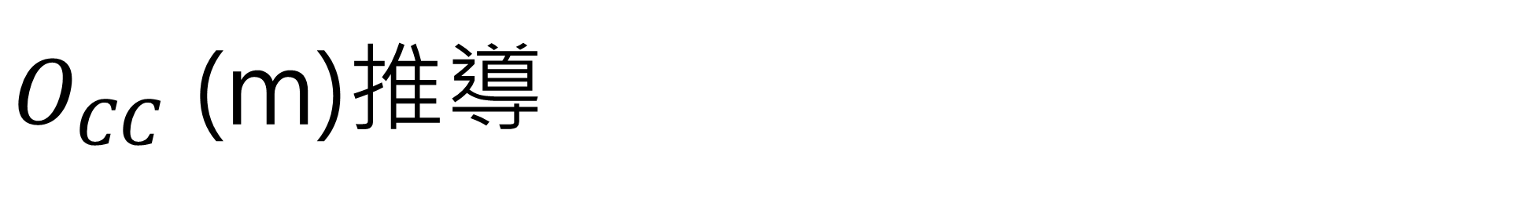


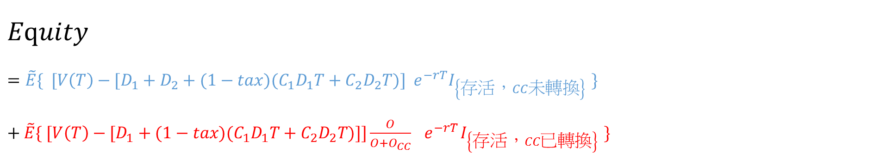
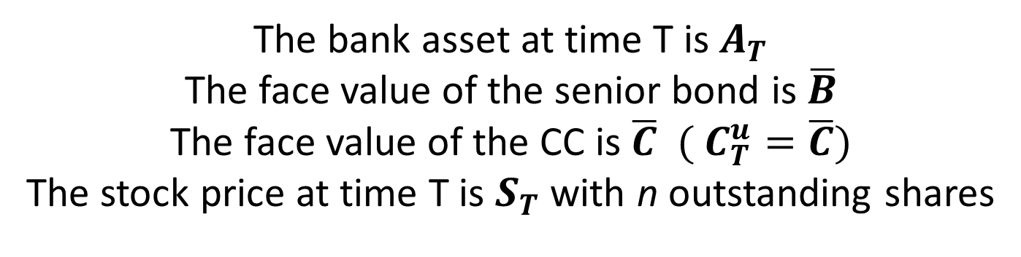
公式推導－$Equity$ ($V_{L}=Debt+Equity$)
$$I(T)$$
$$V\left(T\right)=D_{1}+D_{2}+(1−tax)(C_{1}D_{1}T+C_{2}D_{2}T)$$
存活
且
CC未轉換
$$I\left(T\right)=I(0)$$
$$V(T)=V"=D_{1}+(1+\frac{O}{O_{CC}})D_{2}+(1−tax)(C_{1}D_{1}T+C_{2}D_{2}T)$$
存活
且
CC已轉換
$$V(T)=D_{1}+(1−tax)(C_{1}D_{1}T+C_{2}D_{2}T)$$
$$Equity$$
$$=\tilde{E}\{ [V\left(T\right)−[D_{1}+D_{2}+(1−tax)(C_{1}D_{1}T+C_{2}D_{2}T)]{ e}^{−rT}I_{\left\{存活，CC未轉換\right\} }\}$$
$+ \tilde{E}\{ [V\left(T\right)−[D_{1}+(1−tax)(C_{1}D_{1}T+C_{2}D_{2}T)]]\frac{O}{O+O_{CC}} { e}^{−rT}I_{\left\{存活，CC已轉換\right\} }\}$

Slide 11

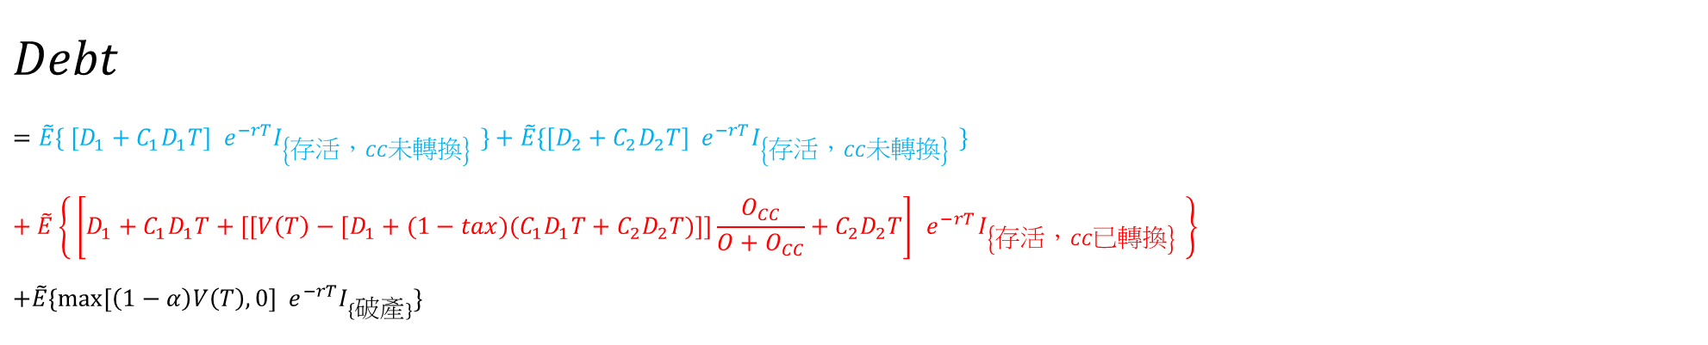

公式推導－$Debt$ ($V_{L}=Debt+Equity$)
$$V(T)=D_{1}+(1−tax)(C_{1}D_{1}T+C_{2}D_{2}T)$$
$$I(T)$$
$$V(T)=V"=D_{1}+(1+\frac{O}{O_{CC}})D_{2}+(1−tax)(C_{1}D_{1}T+C_{2}D_{2}T)$$
破產
且
CC未轉換
SB拿部分
CC分不到
破產
且
CC未轉換
SB拿全部
CC拿部分
存活
且
CC未轉換
$$I\left(T\right)=I(0)$$
破 產
且
CC已轉換
SB拿部分
破 產
且
CC已轉換
SB拿全部
CC拿部分
存活
且
CC已轉換
$$Debt$$
$$=\tilde{E}\{ [D_{1}+C_{1}D_{1}T]{ e}^{−rT}I_{\left\{存活，CC未轉換\right\} }\}+\tilde{E}\{[D_{2}+C_{2}D_{2}T]{ e}^{−rT}I_{\left\{存活，CC未轉換\right\} }\}$$
$$+ \tilde{E}\left\{ \left[D_{1}+C_{1}D_{1}T+[[V\left(T\right)−[D_{1}+(1−tax)(C_{1}D_{1}T+C_{2}D_{2}T)]]\frac{O_{CC}}{O+O_{CC}}+C_{2}D_{2}T\right]{ e}^{−rT}I_{\left\{存活，CC已轉換\right\} }\right\}$$
$$+\tilde{E}\{max⁡[\left(1−α\right)V\left(T\right),0]{ e}^{−rT}I_{\{破產\}}\}$$
$$\left(1−α\right)V\left(T\right)=D_{1}+C_{1}D_{1}T$$
$$V\left(T\right)=D_{1}+D_{2}+(1−tax)(C_{1}D_{1}T+C_{2}D_{2}T)$$

Slide 12

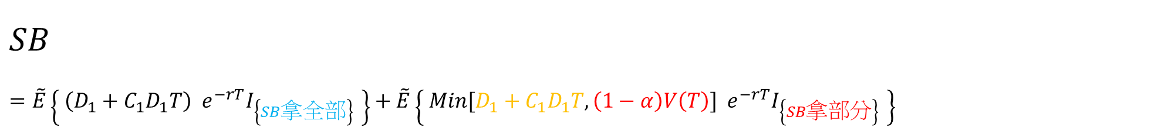
公式推導－$SB$ ($V_{L}=Debt+Equity$)
$$V(T)=D_{1}+(1−tax)(C_{1}D_{1}T+C_{2}D_{2}T)$$
$$I(T)$$
$$V(T)=V"=D_{1}+(1+\frac{O}{O_{CC}})D_{2}+(1−tax)(C_{1}D_{1}T+C_{2}D_{2}T)$$
破產
且
CC未轉換
SB拿部分
CC分不到
破產
且
CC未轉換
SB拿全部
CC拿部分
存活
且
CC未轉換
$$I\left(T\right)=I(0)$$
破 產
且
CC已轉換
SB拿部分
破 產
且
CC已轉換
SB拿全部
CC拿部分
存活
且
CC已轉換
$$SB$$
$$=\tilde{E}\left\{ \left(D_{1}+C_{1}D_{1}T\right){ e}^{−rT}I_{\left\{SB拿全部\right\} }\right\}+\tilde{E}\left\{ Min[D_{1}+C_{1}D_{1}T, \left(1−α\right)V\left(T\right)]{ e}^{−rT}I_{\left\{SB拿部分\right\} }\right\}$$
$$\left(1−α\right)V\left(T\right)=D_{1}+C_{1}D_{1}T$$
$$V\left(T\right)=D_{1}+D_{2}+(1−tax)(C_{1}D_{1}T+C_{2}D_{2}T)$$

Slide 13



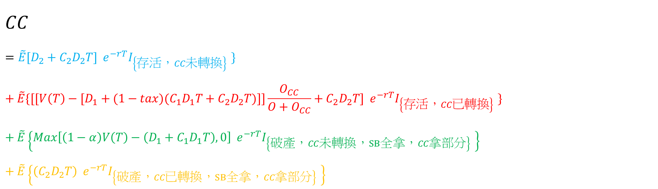
公式推導－$CC$ ($V_{L}=Debt+Equity$)
$$V(T)=D_{1}+(1−tax)(C_{1}D_{1}T+C_{2}D_{2}T)$$
$$I(T)$$
$$V(T)=V"=D_{1}+(1+\frac{O}{O_{CC}})D_{2}+(1−tax)(C_{1}D_{1}T+C_{2}D_{2}T)$$
破產
且
CC未轉換
SB拿全部
CC拿部分
存活
且
CC未轉換
$$I\left(T\right)=I(0)$$
破 產
且
CC已轉換
SB拿全部
CC拿部分
存活
且
CC已轉換
$$CC$$
$$=\tilde{E}[D_{2}+C_{2}D_{2}T]{ e}^{−rT}I_{\left\{存活，CC未轉換\right\} }\}$$
$$+ \tilde{E}\{[[V\left(T\right)−[D_{1}+(1−tax)(C_{1}D_{1}T+C_{2}D_{2}T)]]\frac{O_{CC}}{O+O_{CC}}+C_{2}D_{2}T]{ e}^{−rT}I_{\left\{存活，CC已轉換\right\} }\}$$
$$+ \tilde{E}\left\{Max\left[\left(1−α\right)V\left(T\right)−\left(D_{1}+C_{1}D_{1}T\right),0\right]{ e}^{−rT}I_{\left\{破產，CC未轉換，SB全拿，CC拿部分\right\} }\right\}$$
$$+ \tilde{E}\left\{\left(C_{2}D_{2}T\right){ e}^{−rT}I_{\left\{破產，CC已轉換，SB全拿，CC拿部分\right\} }\right\}$$
$$\left(1−α\right)V\left(T\right)=D_{1}+C_{1}D_{1}T$$
$$V\left(T\right)=D_{1}+D_{2}+(1−tax)(C_{1}D_{1}T+C_{2}D_{2}T)$$

Slide 14
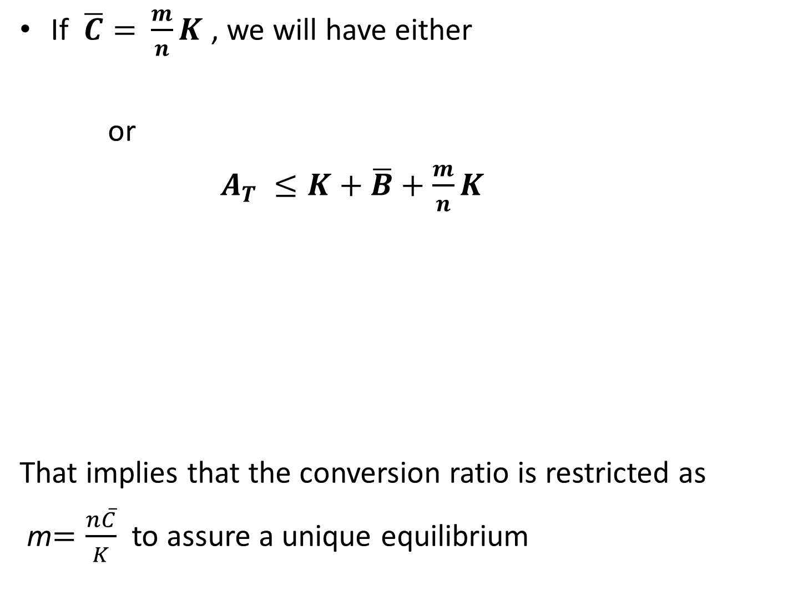

公式推導－$V_{L}=V_{A}+TB −BC$
$$V_{A}=Call\left(X=0\right)$$
$$TB$$
$$=\tilde{E}\{ tax\left(C_{1}D_{1}T+C_{2}D_{2}T\right){ e}^{−rT}I_{\left\{存活\right\} }\}$$
$$= tax(C_{1}D_{1}T+C_{2}D_{2}T){ e}^{−rT}\tilde{E}\{I_{\left\{存活\right\} }\}$$
$$BC$$
$$=\tilde{E}\left[αV(T)e^{−rT}I_{\left\{破產\right\}}\right]$$
$$=αV(0)e^{−rT}\tilde{E}\left[e^{σ_{1}B_{1}\left(T\right)}I_{\left\{破產\right\}}\right]$$

Slide 15
SB + CC 分析圖
$$\left(1−α\right)V\left(T\right)=D_{1}+C_{1}D_{1}T$$
$$I(T)$$
$$V\left(T\right)=D_{1}+D_{2}+(1−tax)(C_{1}D_{1}T+C_{2}D_{2}T)$$
破產
且
CC未轉換
SB拿部分
破產
且
CC未轉換
SB拿全部
CC拿部分
存活
且
CC未轉換
$$I\left(T\right)=I(0)$$
破 產
且
CC已轉換
SB拿全部
CC拿部分
破 產
且
CC已轉換
SB拿部分
$$V(T)=D_{1}+(1−tax)(C_{1}D_{1}T+C_{2}D_{2}T)$$
存活
且
CC已轉換
$$V(T)=V"=D_{1}+(1+\frac{O}{O_{CC}})D_{2}+(1−tax)(C_{1}D_{1}T+C_{2}D_{2}T)$$

Slide 16
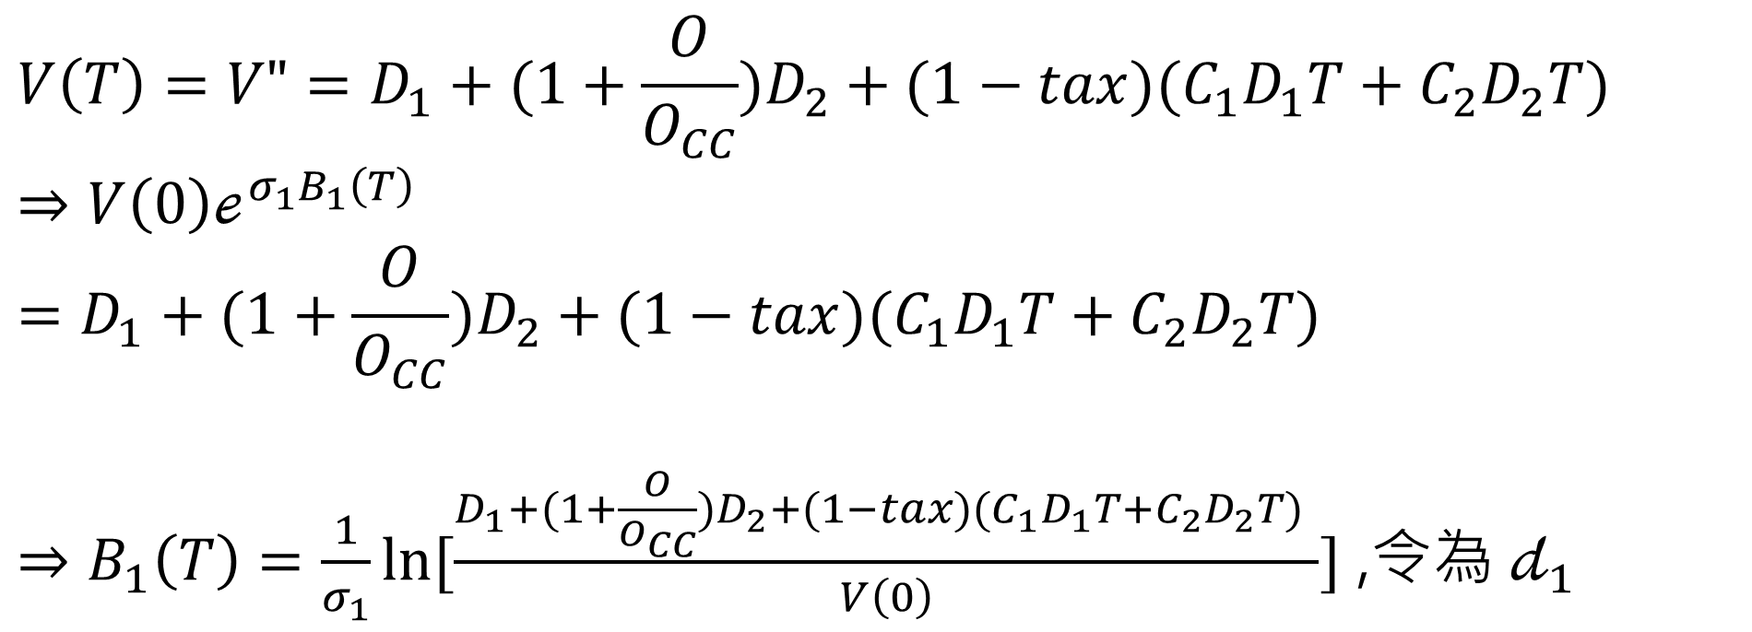
邊界設定(1/5)
1. CC轉換的邊界(與股價有關)
$$V\left(T\right)=V"=D_{1}+(1+\frac{O}{O_{CC}})D_{2}+(1−tax)(C_{1}D_{1}T+C_{2}D_{2}T)$$
$$⇒V\left(0\right)ℯ^{σ_{1}B_{1}\left(T\right)}=D_{1}+(1+\frac{O}{O_{CC}})D_{2}+(1−tax)(C_{1}D_{1}T+C_{2}D_{2}T)$$
$⇒B_{1}\left(T\right)=\frac{1}{σ_{1}}\ln{[\frac{D_{1}+(1+\frac{O}{O_{CC}})D_{2}+(1−tax)(C_{1}D_{1}T+C_{2}D_{2}T) }{V\left(0\right)}}]$ ,令為 $𝒹_{1}$

Slide 17
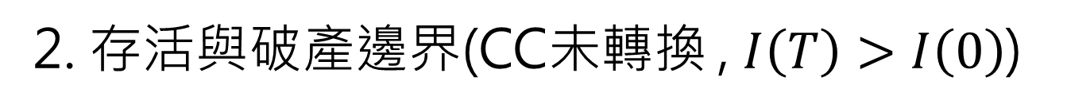
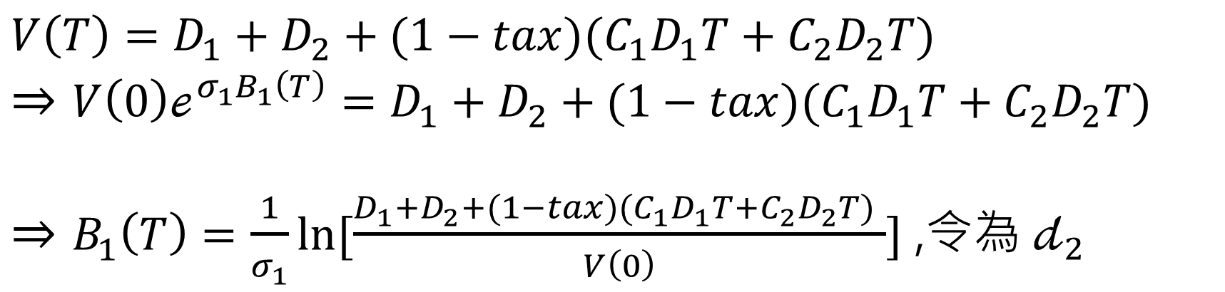
邊界設定(2/5)
2. 存活與破產邊界(CC未轉換 , $I\left(T\right)>I\left(0\right)$)
$$V\left(T\right)=D_{1}+D_{2}+(1−tax)(C_{1}D_{1}T+C_{2}D_{2}T)$$
$$⇒V\left(0\right)ℯ^{σ_{1}B_{1}\left(T\right)}=D_{1}+D_{2}+(1−tax)(C_{1}D_{1}T+C_{2}D_{2}T)$$
$⇒B_{1}\left(T\right)=\frac{1}{σ_{1}}\ln{[\frac{D_{1}+D_{2}+(1−tax)(C_{1}D_{1}T+C_{2}D_{2}T) }{V\left(0\right)}}]$ ,令為 $𝒹_{2}$

Slide 18
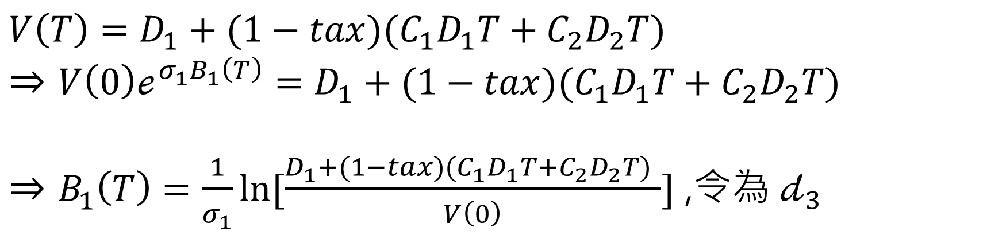
邊界設定(3/5)
3. 存活與破產邊界(CC已轉換)
$$V\left(T\right)=D_{1}+(1−tax)(C_{1}D_{1}T+C_{2}D_{2}T)$$
$$⇒V\left(0\right)ℯ^{σ_{1}B_{1}\left(T\right)}=D_{1}+(1−tax)(C_{1}D_{1}T+C_{2}D_{2}T)$$
$⇒B_{1}\left(T\right)=\frac{1}{σ_{1}}\ln{[\frac{D_{1}+(1−tax)(C_{1}D_{1}T+C_{2}D_{2}T) }{V\left(0\right)}}]$ ,令為 $𝒹_{3}$

Slide 19
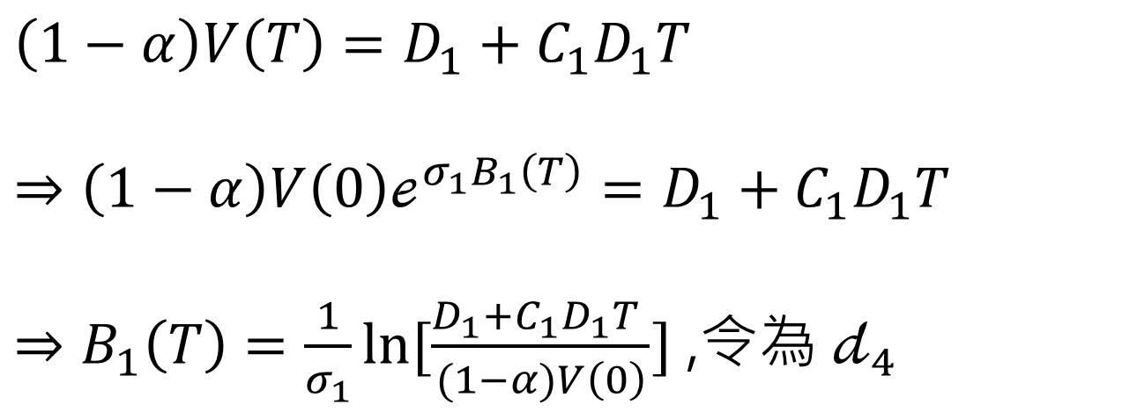
邊界設定(4/5)
4. SB拿全部CC拿部分 與 SB拿部分CC分不到 的邊界
(CC未轉換/轉換)
$$\left(1−α\right)V\left(T\right)=D_{1}+C_{1}D_{1}T$$
$$⇒\left(1−α\right)V\left(0\right)ℯ^{σ_{1}B_{1}\left(T\right)}=D_{1}+C_{1}D_{1}T$$
$⇒B_{1}\left(T\right)=\frac{1}{σ_{1}}\ln{[\frac{D_{1}+C_{1}D_{1}T }{(1−α)V\left(0\right)}}]$ ,令為 $𝒹_{4}$

Slide 20
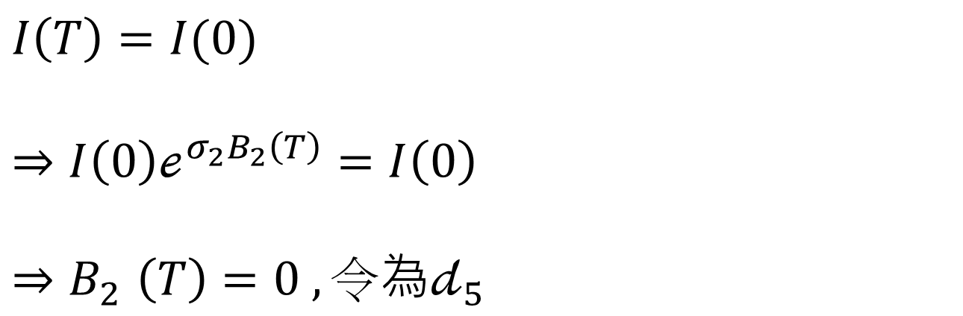
邊界設定(5/5)
5. CC轉換的邊界(與I(T)有關)
$$I\left(T\right)=I(0)$$
$$⇒I\left(0\right)ℯ^{σ_{2}B_{2}\left(T\right)}=I\left(0\right)$$
$${⇒B}_{2}\left(T\right)=0 , 令為𝒹_{5}$$

Slide 21







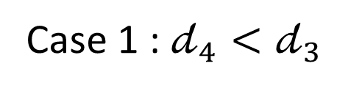
積分範圍(1/4)
Case 1 : $𝒹_{4}<𝒹_{3}$
$$b_{2}$$
$$𝒹_{4}$$
$$𝒹_{2}$$
破產
且
CC未轉換
SB拿部分
CC分不到
破產
且
CC未轉換
SB拿全部
CC拿部分
存活
且
CC未轉換
$$𝒹_{5}$$
$$𝒹_{3}$$
$$𝒹_{1}$$
$$b_{1}$$
破 產
且
CC已轉換
SB拿部分
破 產
且
CC已轉換
SB拿全部
存活
且
CC已轉換

Slide 22


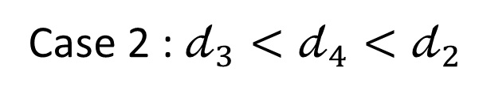
積分範圍(2/4)
Case 2 : $𝒹_{3}<𝒹_{4}<𝒹_{2}$
$$b_{2}$$
$$𝒹_{4}$$
$$𝒹_{2}$$
破產
且
CC未轉換
SB拿部分
CC分不到
破產
且
CC未轉換
SB拿全部
CC拿部分
存活
且
CC未轉換
$$𝒹_{5}$$
$$𝒹_{1}$$
$$b_{1}$$
破 產
且
CC已轉換
SB拿部分
存活
且
CC已轉換
$$𝒹_{3}$$

Slide 23



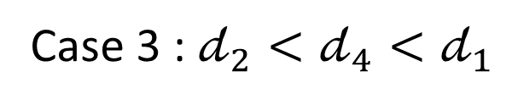
積分範圍(3/4)
Case 3 : $𝒹_{2}<𝒹_{4}<𝒹_{1}$
$$b_{2}$$
$$𝒹_{2}$$
$$𝒹_{4}$$
破產
且
CC未轉換
SB拿部分
CC分不到
存活
且
CC未轉換
$$𝒹_{5}$$
$$𝒹_{1}$$
$$b_{1}$$
破 產
且
CC已轉換
SB拿部分
存活
且
CC已轉換
$$𝒹_{3}$$

Slide 24



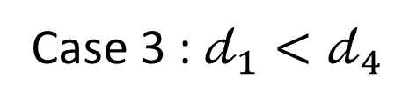
積分範圍(4/4)
Case 3 : $𝒹_{1}<𝒹_{4}$
$$b_{2}$$
$$𝒹_{2}$$
$$𝒹_{4}$$
破產
且
CC未轉換
SB拿部分
CC分不到
存活
且
CC未轉換
$$𝒹_{5}$$
$$b_{1}$$
破 產
且
CC已轉換
SB拿部分
存活
且
CC已轉換
$$𝒹_{3}$$
$$𝒹_{1}$$

Slide 25
The End

Slide 26
附錄

Slide 27
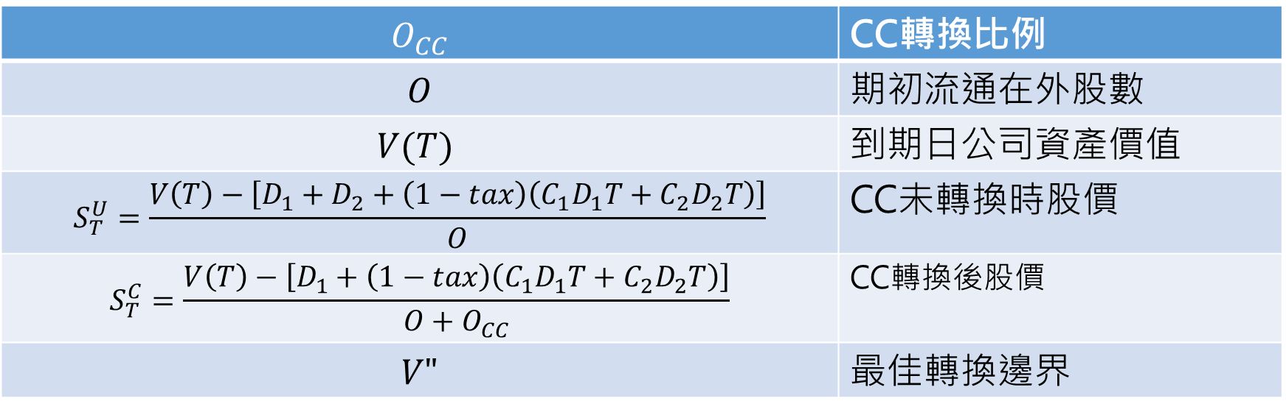
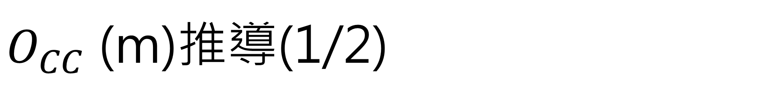
$O_{CC}$ (m)推導(1/2)
$$O_{CC}$$ | CC轉換比例
$$O$$ | 期初流通在外股數
$$V(T)$$ | 到期日公司資產價值
$$S_{T}^{U}=\frac{V\left(T\right)−\left[D_{1}+D_{2}+\left(1−tax\right)\left(C_{1}D_{1}T+C_{2}D_{2}T\right)\right]}{O}$$ | CC未轉換時股價
$$S_{T}^{C}=\frac{V\left(T\right)−\left[D_{1}+\left(1−tax\right)\left(C_{1}D_{1}T+C_{2}D_{2}T\right)\right]}{O+O_{CC}}$$ | CC轉換後股價
$$V"$$ | 最佳轉換邊界
加入債息與稅盾效果

Slide 28
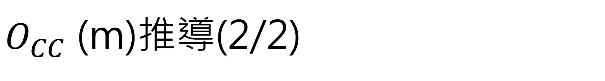
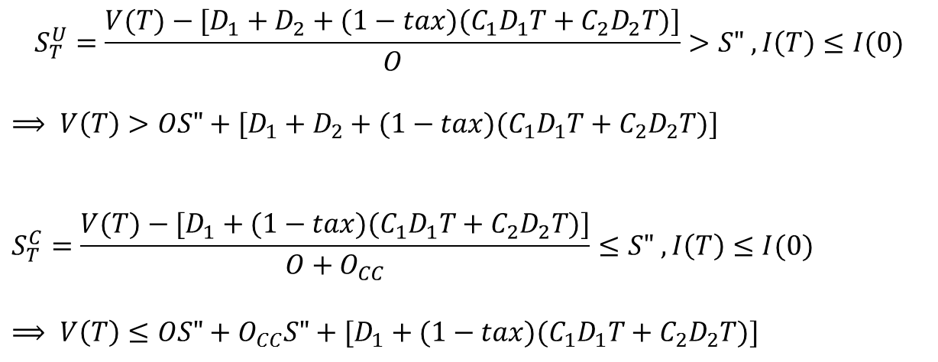
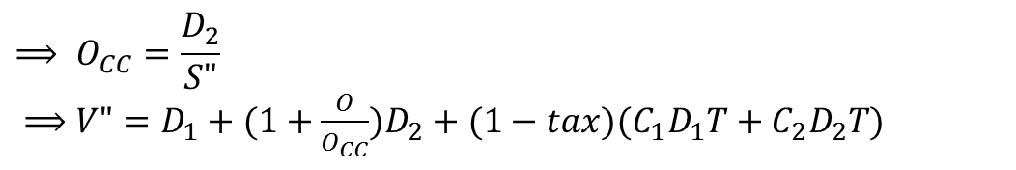

$O_{CC}$ (m)推導(2/2)
$$S_{T}^{U}=\frac{V(T)−[D_{1}+D_{2}+(1−tax)(C_{1}D_{1}T+C_{2}D_{2}T)]}{O}>S" ,I\left(T\right)≤I(0)$$
$$⟹ V\left(T\right)>OS"+[D_{1}+D_{2}+(1−tax)(C_{1}D_{1}T+C_{2}D_{2}T)]$$
$$S_{T}^{C}=\frac{V(T)−[D_{1}+(1−tax)(C_{1}D_{1}T+C_{2}D_{2}T)]}{O+O_{CC}}≤S" ,I\left(T\right)≤I(0)$$
$$⟹ V\left(T\right)≤OS"+O_{CC}S"+[D_{1}+(1−tax)(C_{1}D_{1}T+C_{2}D_{2}T)]$$
$$\left\{\begin{aligned}V\left(T\right)>OS"+[D_{1}+D_{2}+(1−tax)(C_{1}D_{1}T+C_{2}D_{2}T)]=V_{T}^{U} \\ V\left(T\right)≤OS"+O_{CC}S"+[D_{1}+(1−tax)(C_{1}D_{1}T+C_{2}D_{2}T)] =V_{T}^{C}\end{aligned}\right.$$
Let${ V}_{T}^{C} = V_{T}^{U} =V"$
$$V_{T}^{C} =$$
$$V_{T}^{U}$$
$$⟹ O_{CC}=\frac{D_{2}}{S"}$$
$⟹V"=D_{1}+(1+\frac{O}{O_{CC}})D_{2}+(1−tax)(C_{1}D_{1}T+C_{2}D_{2}T)$

Slide 29
The pricing restriction at the maturity of bank’s bonds, t = T
The bank asset at time T is $A_{T}$
The face value of the senior bond is $\overline{B}$
The face value of the CC is $\overline{C} ( C_{T}^{u}=\overline{C})$
The stock price at time T is $S_{T}$ with n outstanding shares
consider the situation at time T

Slide 30
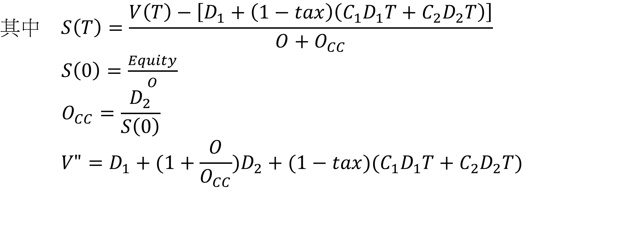
Consider the conversion trigger at time T is K ;
The conversion ratio is m.
Then at time T (maturity),
the stock price as the CC is unconverted
$S_{T}^{u}= \frac{A_{T}−\overline{B}−\overline{C}}{n}$ ;
the stock price as the CC is converted
$S_{T}^{c}= \frac{A_{T}−\overline{B}}{n+m}$ .

Slide 31
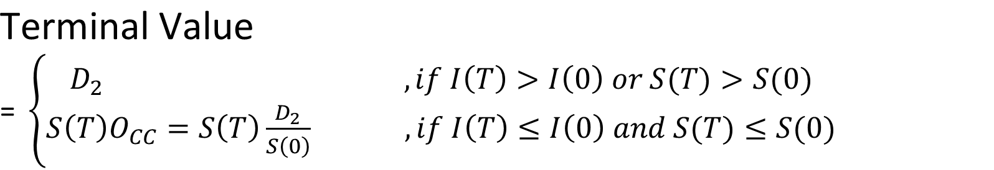
Since the CC stays unconverted at time T if and only if
$nS_{T}^{u}>K$
That implies, given
$S_{T}^{u}= \frac{A_{T}−\overline{B}−\overline{C}}{n}$
$→ A_{T}=nS_{T}^{u}+\overline{B}+\overline{C}$,
$A_{T}>K+\overline{B}+\overline{C}$ if CC is unconverted at time T

Slide 32
As the same token, since the CC should be converted at time T if and only if
$nS_{T}^{c}≤K$, ($S_{T}^{c}≤\frac{K}{n}$)
That implies, given
$S_{T}^{c}= \frac{A_{T}−\overline{B}}{n+m}$
$→ A_{T}=nS_{T}^{c}+mS_{T}^{c}+\overline{B}$ ,
$A_{T} ≤K+ \frac{m}{n}K+\overline{B}$ , if CC is converted at time T

Slide 33
Given $A_{T}>K+\overline{B}+\overline{C}$ for the CC is unconverted at T
$A_{T} ≤K+\overline{B}+\frac{m}{n}K$ for the CC is converted at T
If $\overline{C}<$ $\frac{m}{n}K$
Then
$A_{T} ∈(K+\overline{B}+\overline{C}$, $K+\overline{B}+\frac{m}{n}K$ ]
$A_{T}$
unconverted
$K+\overline{B}+\frac{m}{n}K$
Both converted and
unconverted are met
$$K+\overline{B}+\overline{C}$$
converted

Slide 34

If $\overline{C}>$ $\frac{m}{n}K$
Then
$A_{T} ∈(K+\overline{B}+\frac{m}{n}K$, $K+\overline{B}+\overline{C} )$
$A_{T}$
unconverted
$$K+\overline{B}+\overline{C}$$
Neither converted nor
unconverted is met
$K+\overline{B}+\frac{m}{n}K$
converted

Slide 35
If $\overline{C}=$ $\frac{m}{n}K$ , we will have either
or
$A_{T} ≤K+\overline{B}+\frac{m}{n}K$
That implies that the conversion ratio is restricted as
m$=\frac{n\overline{C}}{K}$ to assure a unique equilibrium
$A_{T}>K+\overline{B}+\overline{C}$ ,
unconverted
$K+\overline{B}+\overline{C}$ = $K+\overline{B}+\frac{m}{n}K$
converted

Slide 36
Question

Slide 37


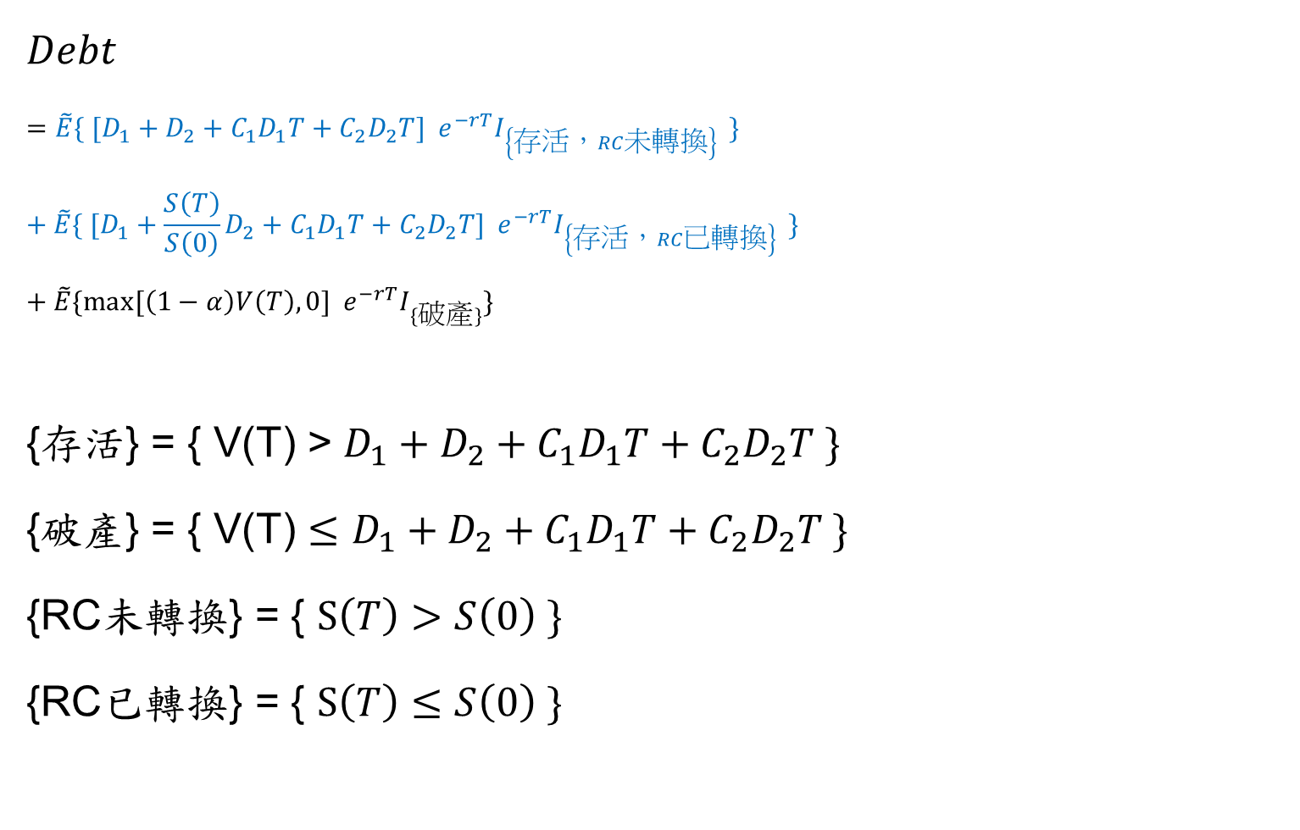
鄭&張paper公式推導－以$Debt$為例
$$Debt$$
$$=\tilde{E}\{ [D_{1}+D_{2}+C_{1}D_{1}T+C_{2}D_{2}T]{ e}^{−rT}I_{\left\{存活，RC未轉換\right\} }\}$$
$$+ \tilde{E}\{ [D_{1}+\frac{S\left(T\right)}{S\left(0\right)}D_{2}+C_{1}D_{1}T+C_{2}D_{2}T]{ e}^{−rT}I_{\left\{存活，RC已轉換\right\} }\}$$
$$+ \tilde{E}\{max⁡[\left(1−α\right)V\left(T\right),0]{ e}^{−rT}I_{\{破產\}}\}$$
{存活} = { V(T) > $D_{1}+D_{2}+C_{1}D_{1}T+C_{2}D_{2}T \}$
{破產} = { V(T) $≤$ $D_{1}+D_{2}+C_{1}D_{1}T+C_{2}D_{2}T \}$
{RC未轉換} = { $S\left(T\right)>S\left(0\right) \}$
{RC已轉換} = { $S\left(T\right)≤S\left(0\right) \}$
?

